Slide 1
Spatial Inequalities in Emergency Medical Services Response Times in New York City
Team Members: Qianchen Yu, Jia Johnson & Yuanseng Choo
Notes:
We focus on a simple but important question: when someone calls 911 in New York City, does the ambulance arrive equally fast in every neighborhood, or are some places systematically left behind?
To answer this, we combine EMS dispatch records with Census data, and we look at spatial patterns, social inequalities, and predictive models. I’ll first give you some context and then walk through our research framework and data pipeline.”

Slide 2
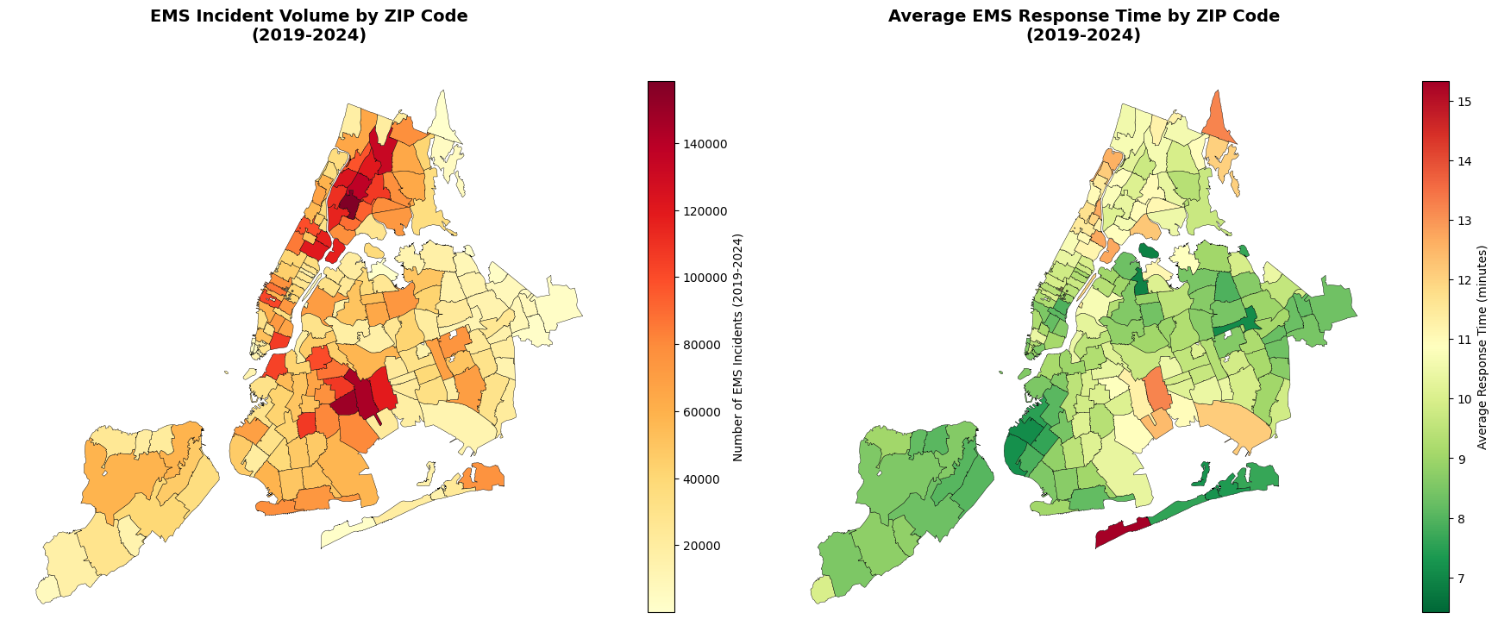
Introduction and Overview
EMS response times are not evenly distributed across NYC.
Some neighborhoods face both high EMS demand and slower average response.
NYC’s social and racial diversity raises concerns about spatial inequality in emergency care.
We combine EMS dispatch and Census data to quantify and explain these inequalities.
Notes:
“Let me start with a quick overview of the problem and the data.
First, EMS response times are not evenly distributed across New York City. If we look at the map on the top right, we see that incident volume is highly concentrated in a few ZIP codes, especially in parts of the Bronx and northern Manhattan. And if we look at the map on the bottom right, average response times also vary a lot across space, with some areas consistently above ten minutes.
So some neighborhoods face both high EMS demand and slower average response. That means they are calling more often, and they are waiting longer. This is not just a workload issue; it also raises concerns about equity and access to timely emergency care.
However, New York City is also extremely diverse in terms of race, income, housing, and health needs. Therefore, we ask whether these spatial differences in response times might be linked to neighborhood socioeconomic and racial composition, rather than just random variation or pure chance.
In this project, we combine several years of EMS dispatch data with 2022 ACS ZIP-code indicators. That allows us to quantify where the inequalities are, and to explain which neighborhood characteristics are most strongly associated with slow EMS response.”

Slide 3
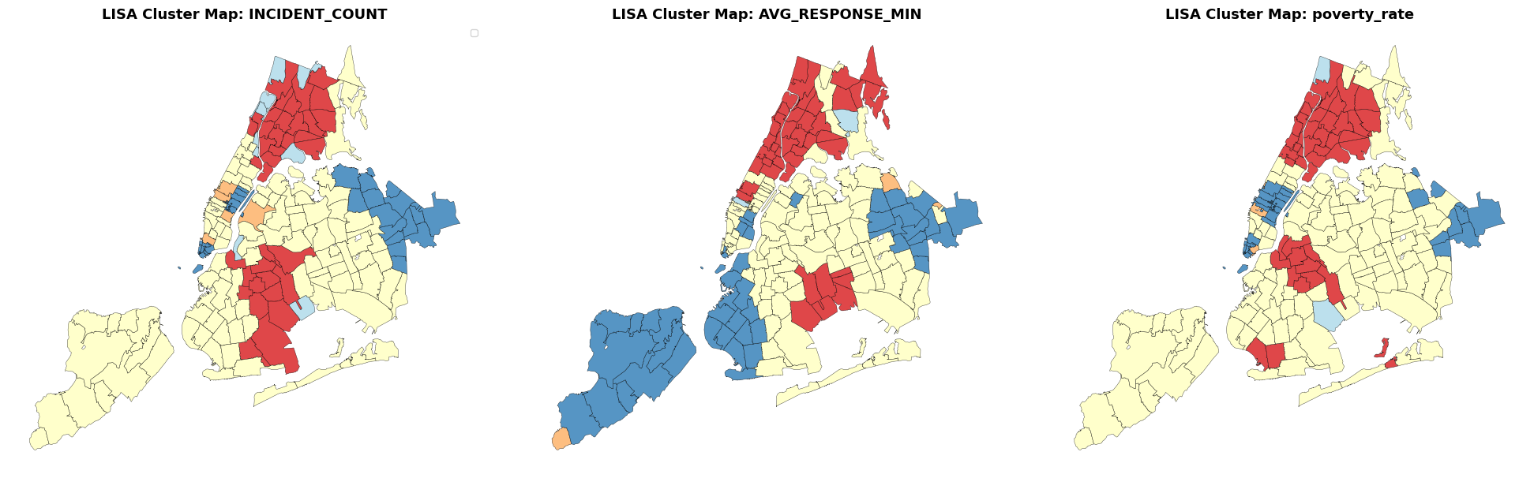
Research Framework
RQ1: What spatial patterns and clusters of EMS demand and response times emerge across NYC ZIP codes?
RQ2: How are slow-response ZIP codes related to neighborhood socioeconomic and racial composition?
RQ3: To what extent can ML models help predict “slow-response” ZIP codes and identify the most important predictors?
Integrate EMS incidents (2019–2024) with ACS 2022 ZIP-code indicators.
Use spatial statistics (Moran’s I, LISA, Gi*) to detect clustered inequalities.
Train and interpret logistic regression and tree-based models to predict slow-response ZIP codes.
Notes:
“Given that motivation, our work is structured around three research questions.
RQ1 asks: what spatial patterns and clusters of EMS demand and response times emerge across NYC ZIP codes? In other words, are high-demand and slow-response areas randomly scattered, or do they form clear clusters on the map? The three LISA cluster maps at the top show clusters for incident counts, average response time, and poverty rate. We use these to visually and statistically identify high–high and low–low neighborhoods.
RQ2 then asks: how are slow-response ZIP codes related to neighborhood socioeconomic and racial composition? Here, we move from description to explanation. We want to know whether slow-response areas are more likely to have higher poverty, higher renter share, or particular racial and ethnic profiles, after we control for overall demand.
Finally, RQ3 asks: to what extent can machine learning models help predict “slow-response” ZIP codes and identify the most important predictors? This question is about prediction and prioritization. If we can reliably predict where slow responses are most likely to occur, then agencies can use those predictions to target resources and monitor equity.
To answer these questions, we integrate EMS incidents with ACS 2022 ZIP-code variables, and we attach ZIP-code geometries for spatial analysis. We use spatial statistics such as Moran’s I and LISA to detect clustered inequalities, and then we train and interpret both logistic regression and tree-based models to predict slow-response ZIP codes and to study the relative importance of different features.”

Slide 4
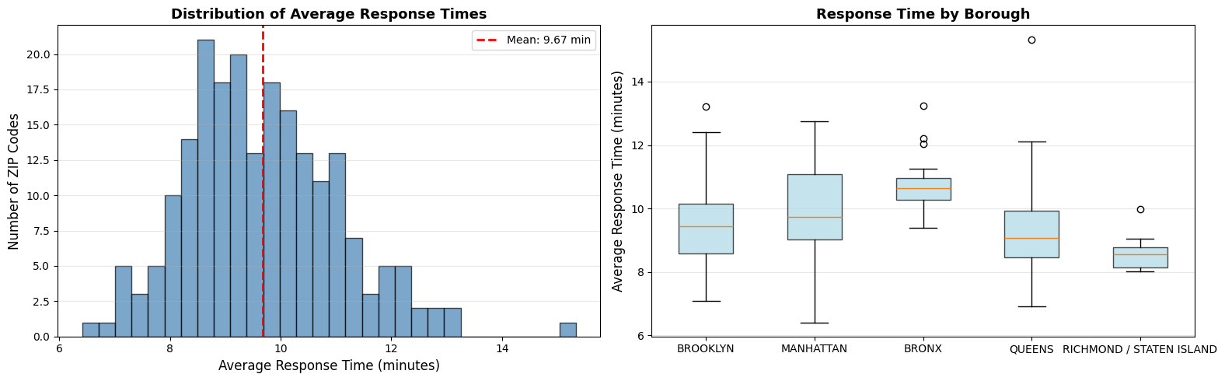
Data Cleaning and Preparation
Clean EMS dispatch records and aggregate 2019–2024 incidents to ZIP-level call counts and average response times.
Retrieve ACS 2022 ZIP-code socioeconomic indicators and compute key rates (poverty, unemployment, education, renter share, race composition, diversity).
Merge EMS, ACS, and ZIP-code geometries; engineer features (incidents per 1,000 residents, response time per incident, hotspot flag, borough encoding).
Drop leakage and missing columns, then build an 80/20 stratified train–test split and scale predictors for the logistic model.
Notes:
“Before modeling, we spent a fair amount of effort on data cleaning and feature engineering.
On the EMS side, we clean the dispatch records and aggregate incidents from 2019 to 2024 to the ZIP-code level. For each ZIP code, we compute total call counts and the average response time. That distribution is shown in the histogram on the left. Most ZIP codes fall between about eight and eleven minutes, and the red dashed line marks the mean response time, which is roughly 9.7 minutes. This distribution also motivates our later threshold of ten minutes for defining “slow-response” ZIP codes.
On the Census side, we retrieve ACS 2022 ZIP-code indicators and compute key rates such as poverty, unemployment, educational attainment, renter share, and race composition, as well as a diversity index. We then merge the EMS data, the ACS data, and ZIP-code geometries into a single dataset, and we engineer additional features like incidents per 1,000 residents, response time per incident, hotspot flags, and borough encoding.
The boxplot on the right compares average response times across boroughs. We can see that the Bronx tends to have higher response times, while Staten Island and parts of Queens are generally lower. This already suggests spatial inequality at the borough level, and it also reinforces the need to control for borough and other contextual factors in our models.
Finally, we drop leakage variables and rows with missing values, and we build an 80/20 stratified train–test split. We also scale predictors for the logistic regression. Therefore, by the time we move to the modeling section, we have a clean, spatially linked dataset that is ready for both interpretive and predictive analysis.”

Slide 5
Logistic Model
Easily interpretable
Performs well
Avoids overfitting (L1)
y = 1 if AVG_RESPONSE_MIN greater than 10 minutes, else 0
RandomizedSearchCV, tested penalty types (L1/L2), regularization strength, solver options and iteration limit
Provides a simply binary outcome to estimate the probability of the response time being greater than 10 minutes
Helpful to identify neighborhoods at risk of slow emergency response time

Slide 6
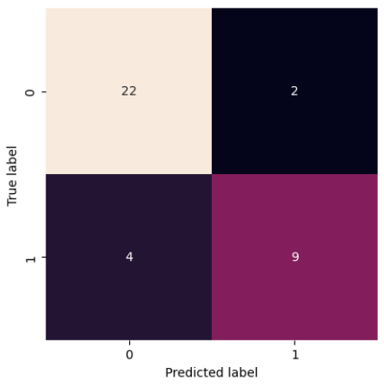
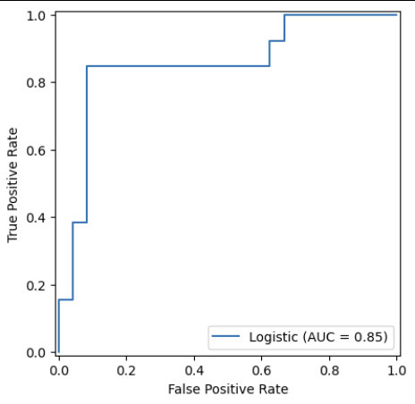
Performance of Logistic Model
Performance:
Training AUC: 0.898
Test AUC: 0.853
Confusion Matrix:
22 True Negatives, 9 True Positives
2 False Positives, 4 False Negatives
ROC Curve: AUC = 0.85 → Model can distinguish fast vs. slow response zones 85% of the time
While this model gives a generalized response of which neighborhoods are at a higher risk for slower response times, it doesn’t capture non-linear relationships which can be better for real life situations.

Slide 7
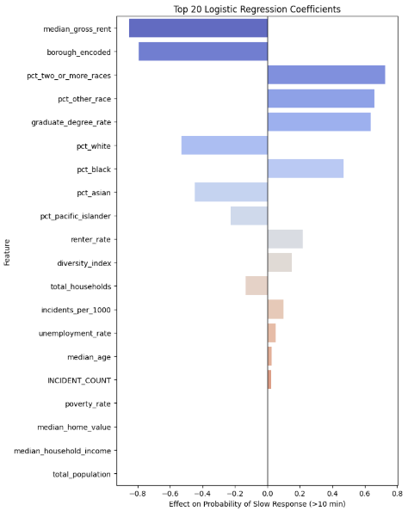
Visualization and Results of Logistic Model
Coefficient Plot
Right side → factors that increase the probability of slow emergency response
Left side → factors that decrease the probability of slow response
Results:
Higher percentages of multiracial residents, renter rate and neighborhood diversity, and graduate degree rate tend to increase the probability of risk of slow response
Higher median gross, percentage of white residents and more total households decrease the risk of slow response

Slide 8
Non-Logistic Models
y = 1 if AVG_RESPONSE_MIN greater than 10 minutes, else 0
Capture nonlinear relationships
Better suited for mixed socioeconomic, demographic, and spatial data
Useful for deeper interactions, identifying high-risk ZIP codes

Slide 9
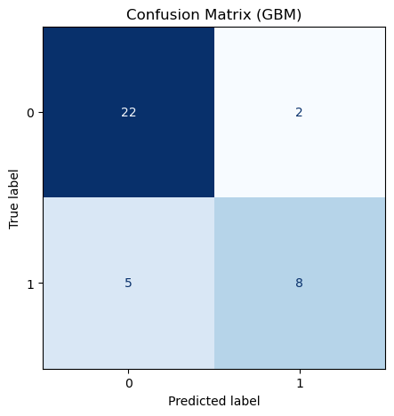
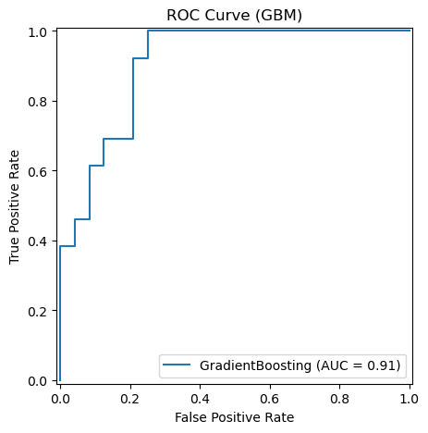
Non-Logistic Model (GradientBoostingClassifier)
Performance:
Training AUC: 1.0
Test AUC: 0.907
Confusion Matrix:
22 True Negatives, 8 True Positives
2 False Positives, 5 False Negatives
ROC Curve: AUC = 0.91 → Model can distinguish fast vs. slow response zones 91% of the time
Delivers strong predictive accuracy
Captures complex, nonlinear patterns and feature interactions

Slide 10
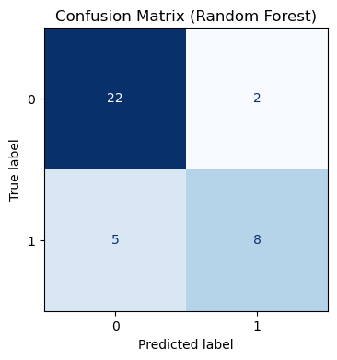
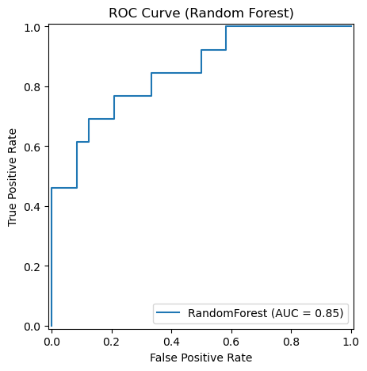
Non-Logistic Regression (Random Forest Classifier)
Performance:
Training AUC: 1.0
Test AUC: 0.853
Confusion Matrix:
22 True Negatives, 8 True Positives
2 False Positives, 5 False Negatives
ROC Curve: AUC = 0.85 → Model can distinguish fast vs. slow response zones 85% of the time
Robust and stable performance
Handles high-dimensional datasets

Slide 11
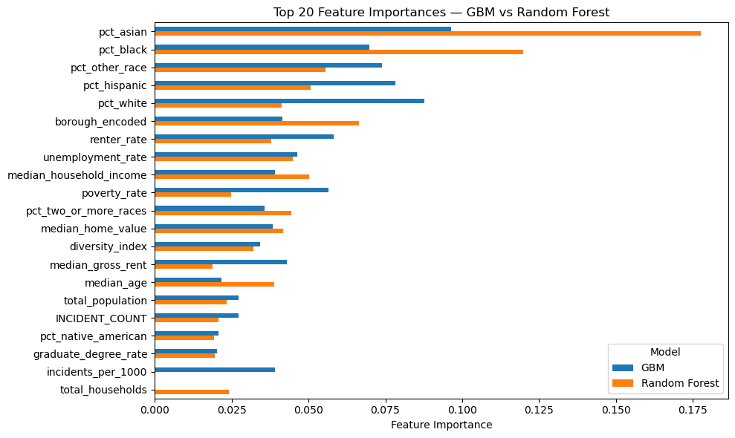
Visualization and Results of Non-Logistic Model
Race and ethnicity variables (pct_asian, pct_black, pct_other_race, pct_hispanic) are the strongest predictors of delayed EMS response
GBM and Random Forest agree on the general ranking, but GBM distributes importance across more features, while Random Forest emphasizes a few predictors more strongly (e.g., pct_asian, pct_black).
A complex mix of socioeconomic, demographic, and geographic factors

Slide 12
Discussion
 | Logistic Regression | Gradient Boosting Classifier | Random Forest Classifier
AUC for Training | 0.898 | 1.00 | 1.00
AUC for Testing | 0.853 | 0.907 | 0.850
Gradient Boosting Classifier has the highest test AUC, but both tree-based models showed signs of overfitting. But, GBM generalization is still strong.
The logistic regression offers a strong performance and has a lower overfitting risk and clearer interpretation.

Slide 13

Conclusion
Neighborhood race, housing, and poverty metrics predict slow EMS response more strongly than demand volume alone.
EMS demand and response times are strongly clustered in space, rather than randomly distributed across NYC ZIP codes.
Spatial statistics (Moran’s I and LISA) show clear high–high clusters for both slow response times and socioeconomic disadvantage (e.g., poverty, unemployment).
Across models, neighborhood context matters: ZIP codes with higher poverty, higher renter share, and more racially diverse populations are more likely to be classified as “slow-response” areas (>10 minutes).
Machine-learning models predict slow-response ZIP codes with strong out-of-sample performance (Logistic/RF AUC ≈ 0.85, Gradient Boosting AUC ≈ 0.91), confirming that these inequalities are systematic and measurable.
Top 10 Feature Importance

Slide 14
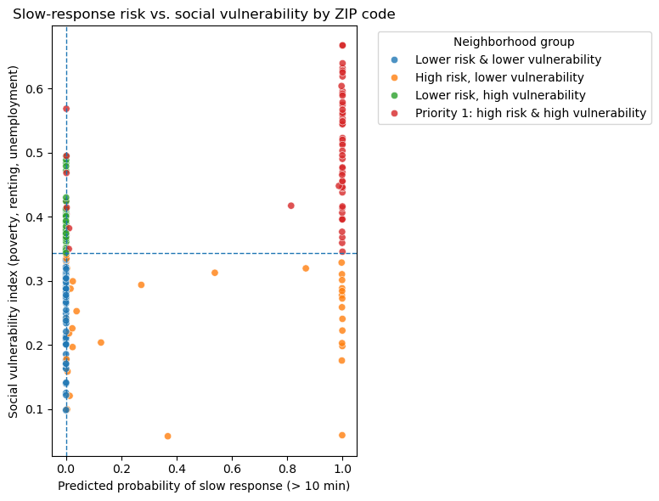
Business interpretation
Predictive risk scores + social vulnerability maps = a clear playbook for EMS equity targeting.
Risk × Vulnerability Quadrant Scatter
Prioritize high-risk, high-need neighborhoods.
Build equity metrics into EMS performance dashboards.
Inform strategic planning and scenario analysis.
Support cross-agency interventions.
Notes:
“So far we have treated this as a statistical and modeling problem, and the models tell us that slow EMS response is both predictable and unequal across neighborhoods.
On this slide, we shift to a business and policy perspective. The scatterplot on the right puts our results into a simple decision space. The horizontal axis shows the predicted probability of slow response from our Gradient Boosting model. The vertical axis shows a social vulnerability index that averages poverty, renter share, and unemployment. Each dot is a ZIP code.
We draw one vertical line and one horizontal line at the median values, and that divides the city into four groups. ZIP codes in the upper-right quadrant have both high predicted risk and high vulnerability. These are the Priority 1 neighborhoods in our framework. ZIP codes in the lower-right quadrant have high risk but lower vulnerability, so they look more like operational hotspots. In contrast, the upper-left quadrant has lower predicted risk but high vulnerability, which suggests places we may want to monitor, in case service gaps grow over time.
However, the key point is not the exact cutoffs. The key point is that we can move from a long list of ZIP codes to a small set of clearly defined groups, using data that the city already collects. This gives managers a transparent way to explain why some neighborhoods should be first in line for extra units, new posts, or pilot interventions.
Therefore, our main recommendation is to link these risk scores with routine planning and reporting. First, agencies can prioritize high-risk, high-vulnerability ZIP codes when they allocate new resources or redesign coverage. Second, they can build equity metrics into EMS dashboards, by tracking the share of calls over ten minutes in each quadrant. Third, they can use this risk–vulnerability map as a starting point for scenario analysis and cross-agency work, combining it with public health or planning data to coordinate broader investments.

